Slide 1
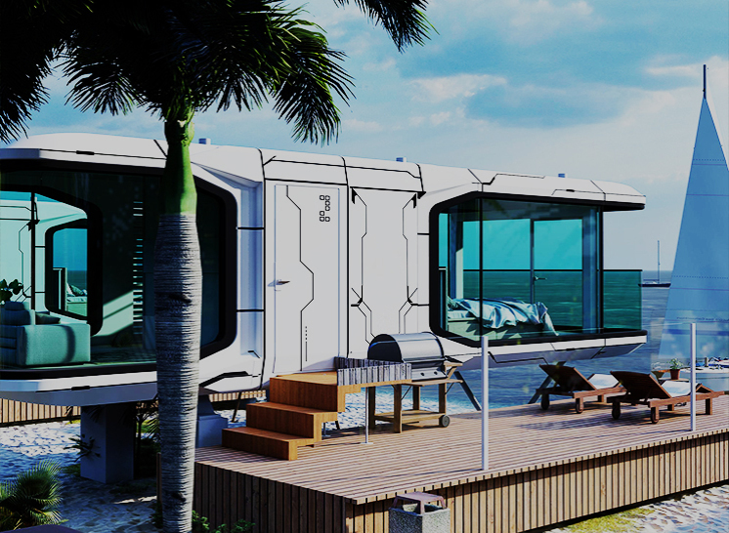
Space Capsule Smart Home Technology Fashion and Eco-Friendliness

Slide 2
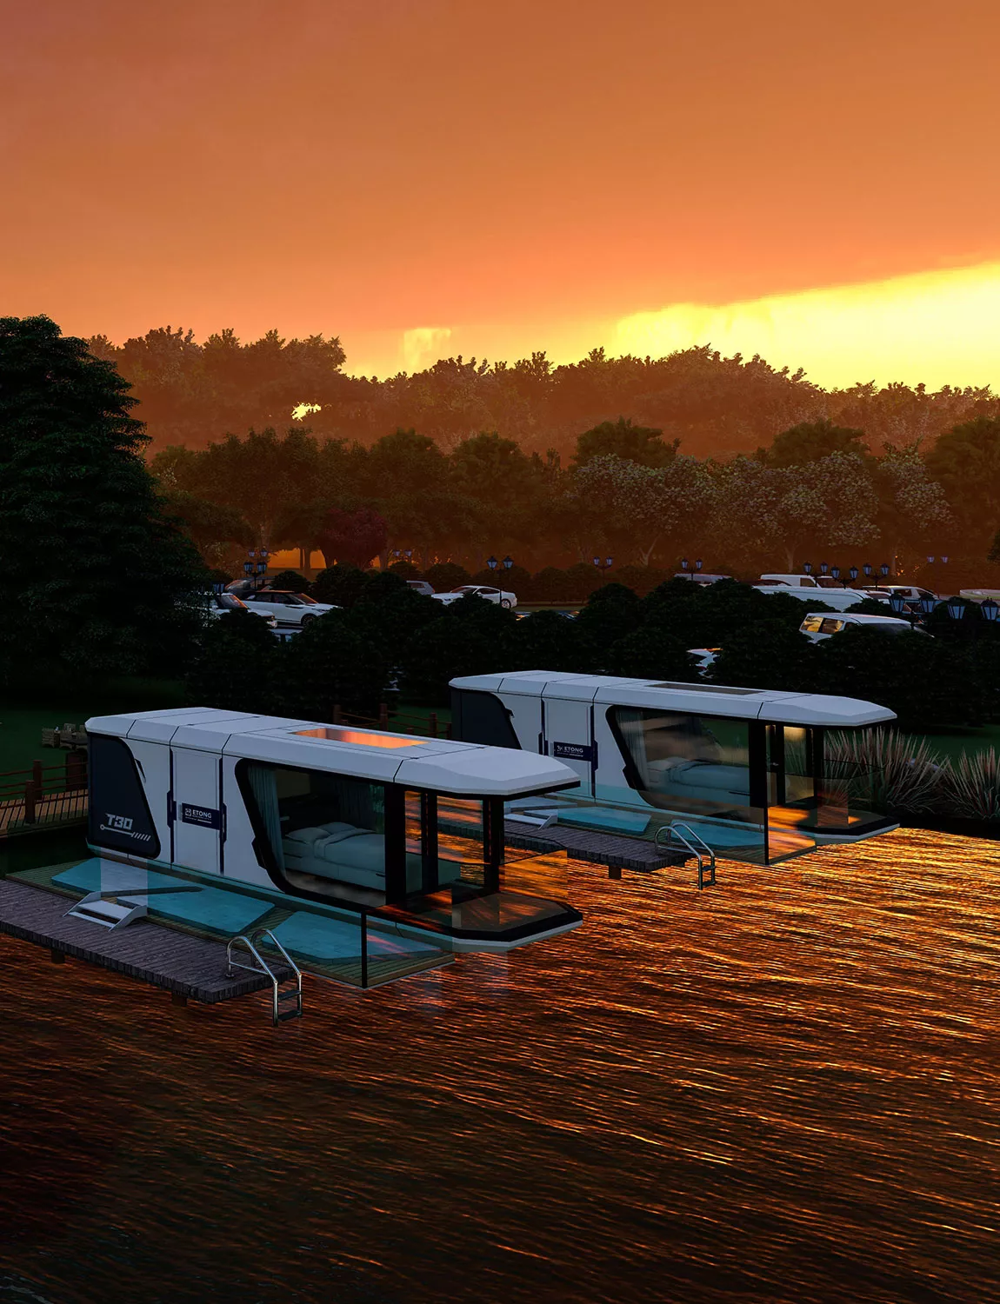
Our Vision
Innovative leader in Canadian housing construction

Slide 3
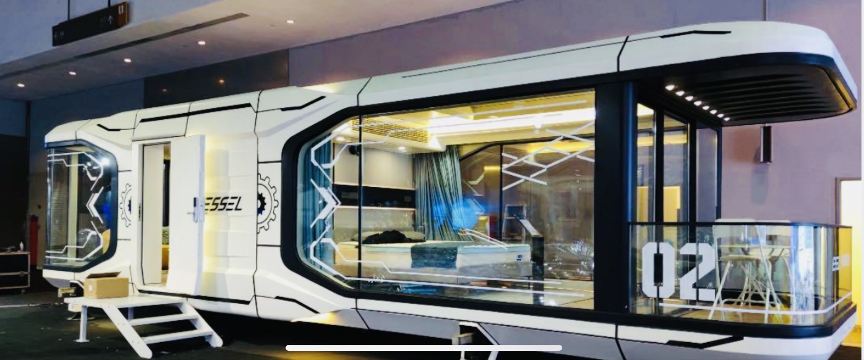
Our Mission
Comfortable, intelligent, eco-friendly living

Slide 4
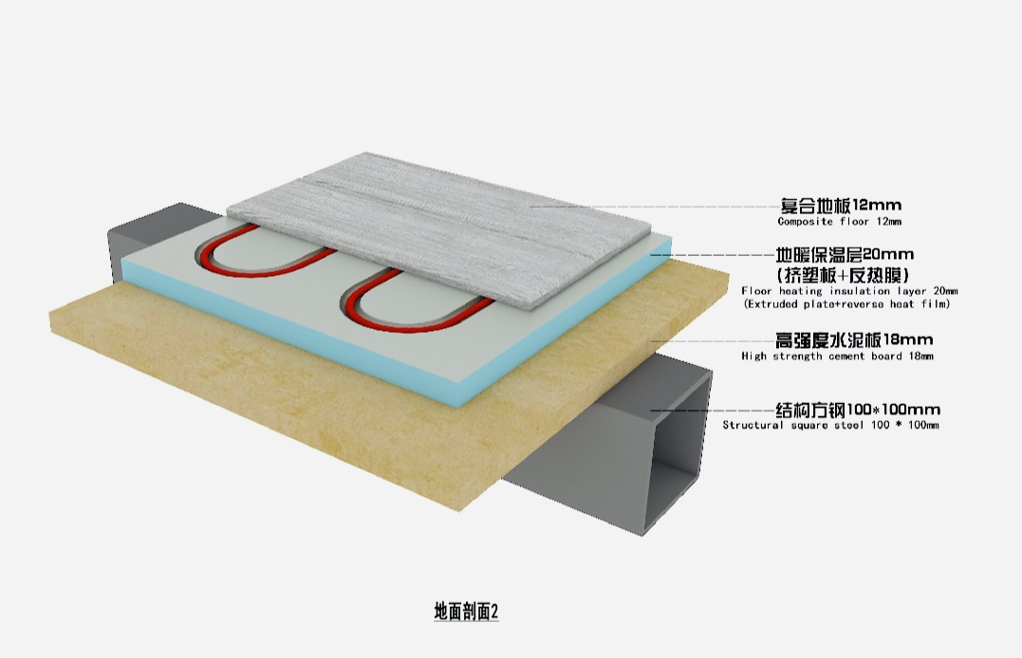
Energy Saving and Eco-Friendly
Solar power generation system
Triple-glazed doors and windows
Air exchange system
LED lights and light strips
Geothermal system

Slide 5
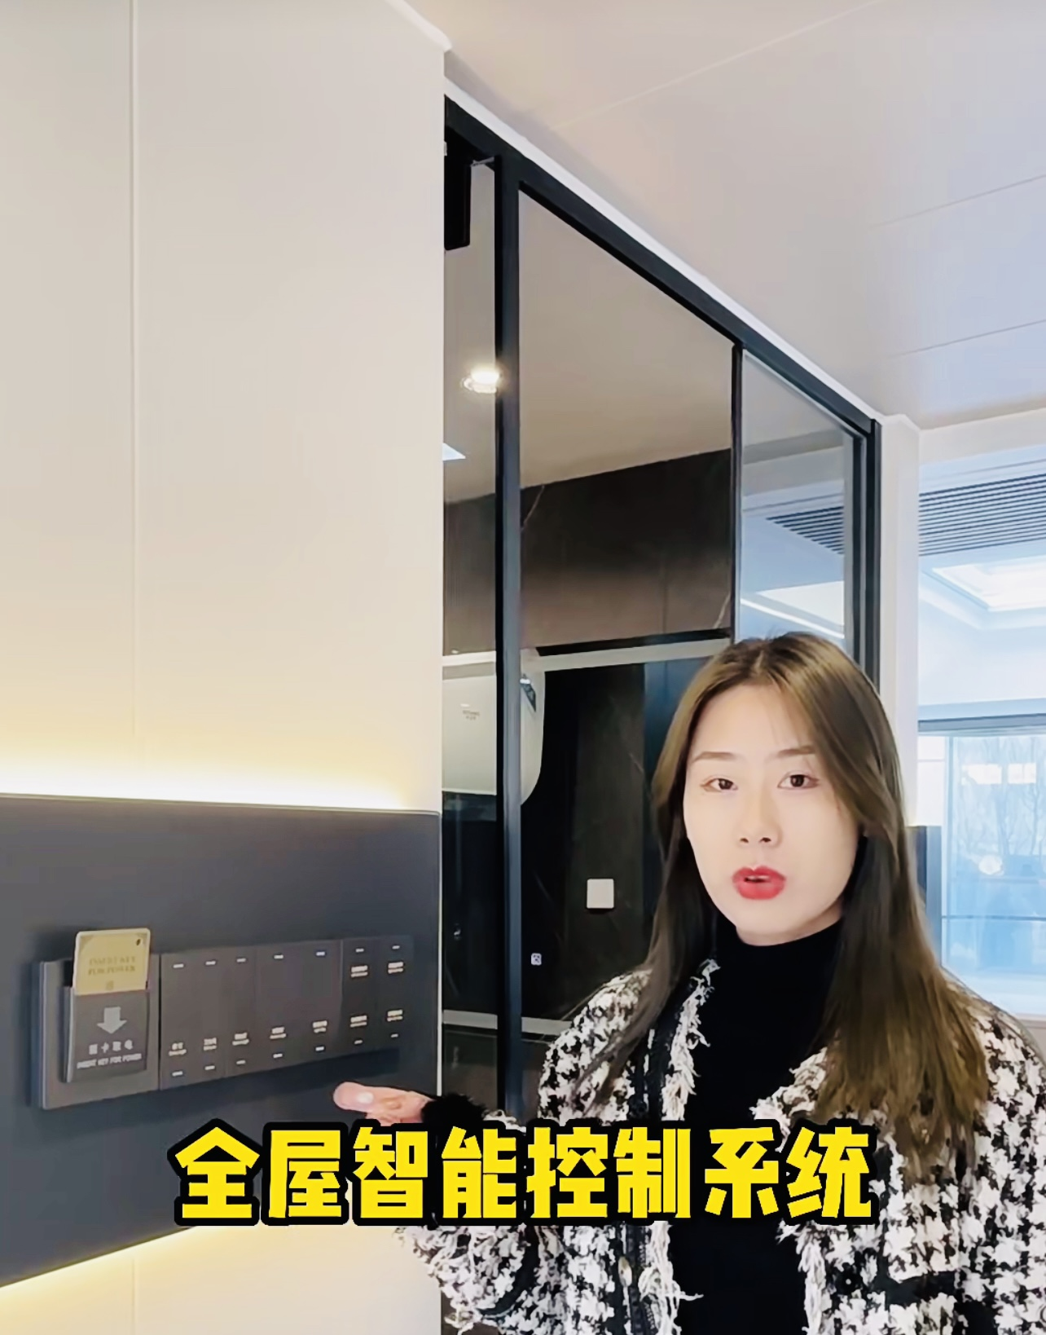
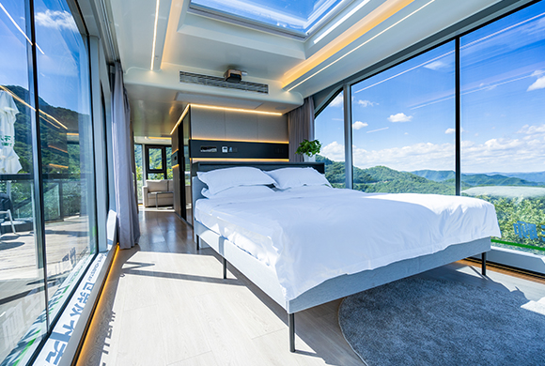
Smart Home Technology
Whole-house smart control system
Smart door lock
Smart toilet
Smart curtain switch
Smart background music system
Smart lighting control

Slide 6
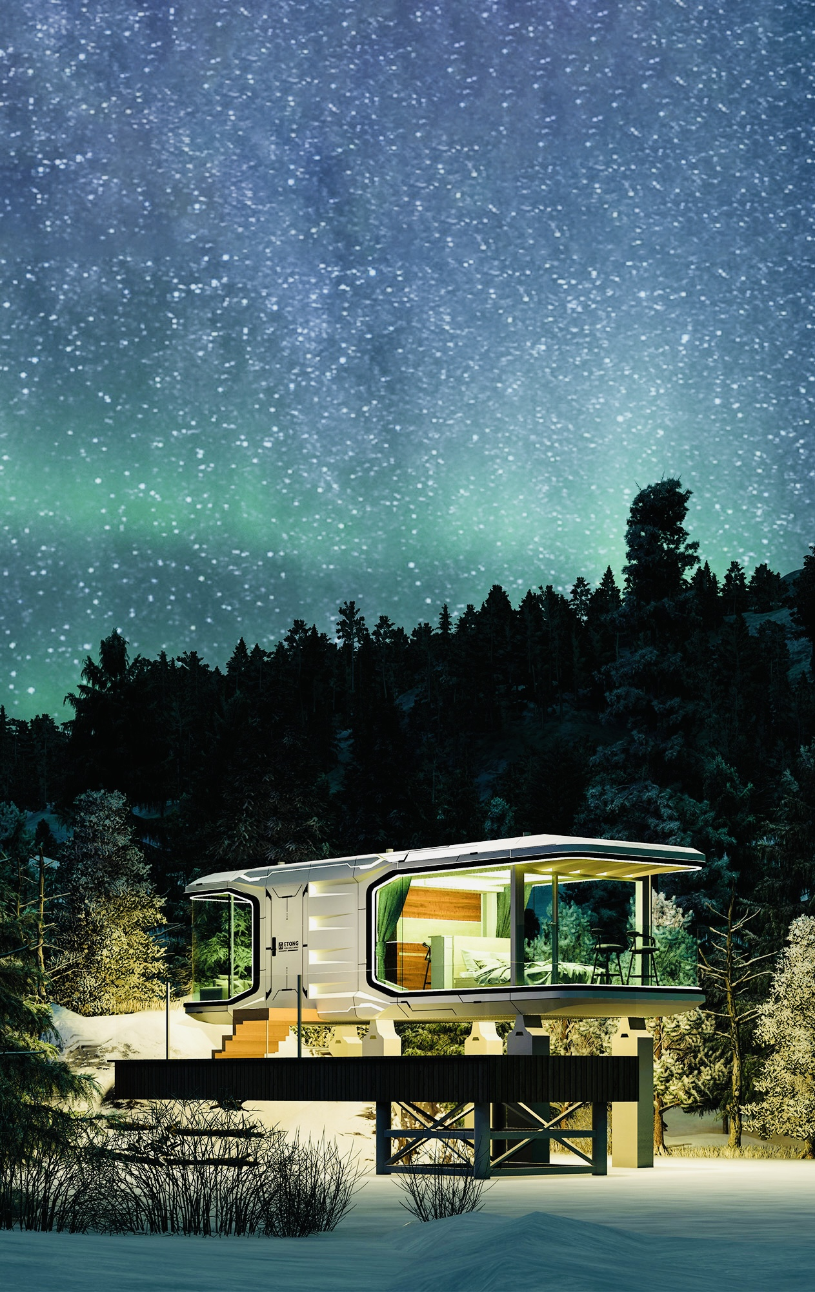
Modern Design
Aviation-grade aluminum exterior
Streamlined appearance
Stunning light fixtures
Large floor-to-ceiling windows
Rooftop skylight
Modern furniture

Slide 7
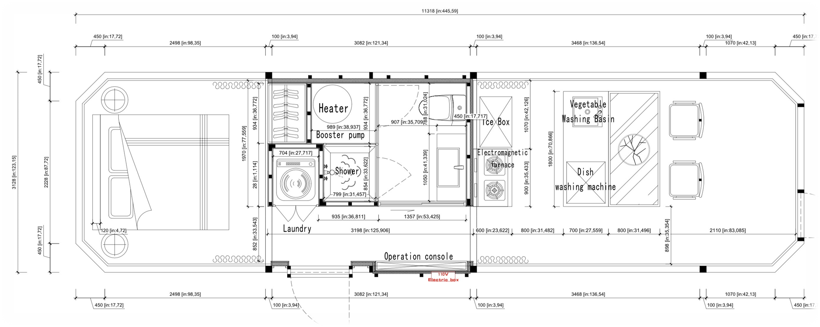
Easy Mobility
40-foot flatbed trailer transport
Quick hoisting to base

Slide 8
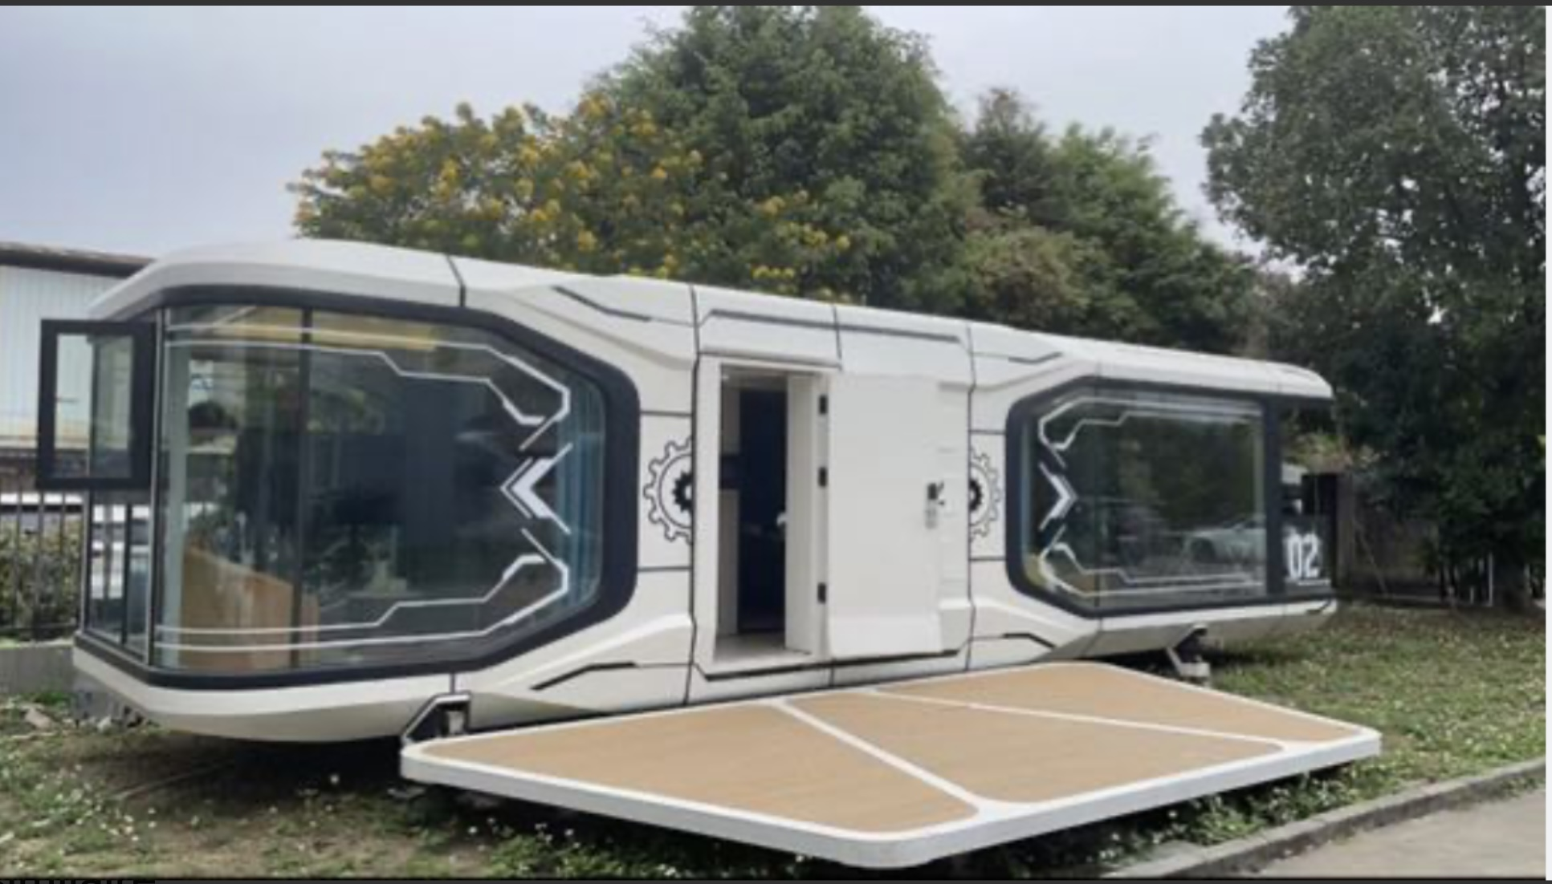
Durable and Long-lasting
Aviation-grade aluminum exterior
Aluminum alloy interior finish
High-quality plumbing and electrical systems
50-year service life

Slide 9
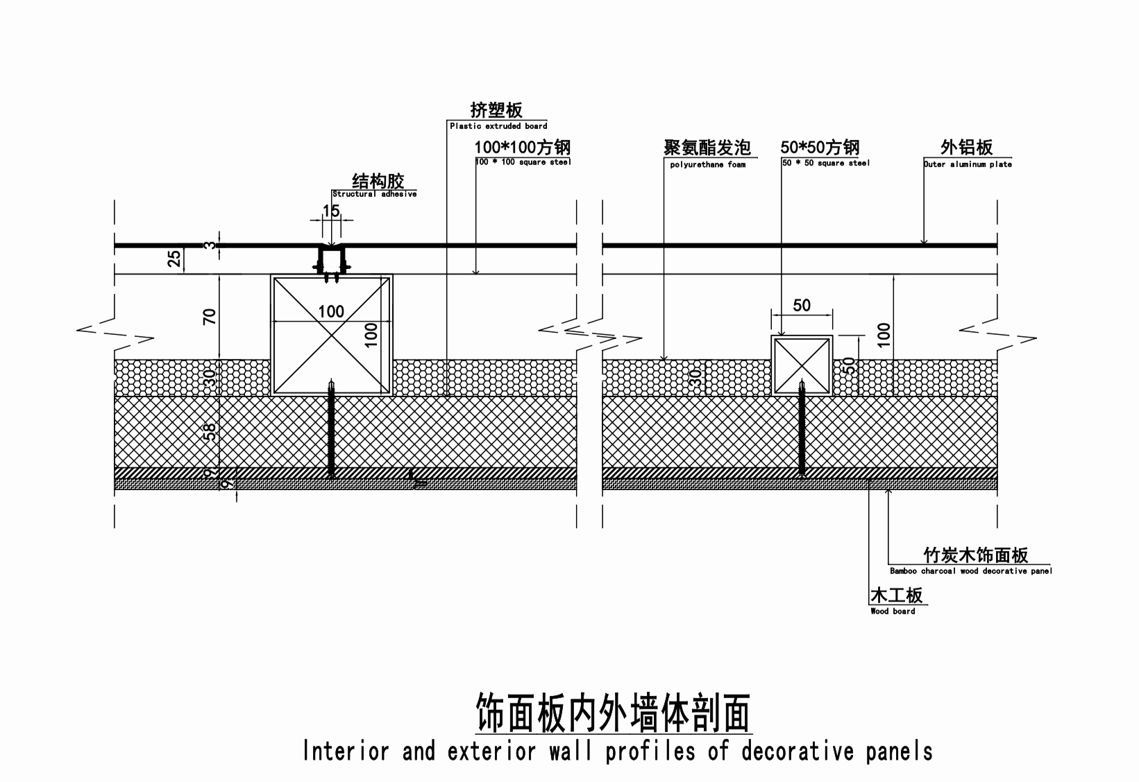

Slide 10
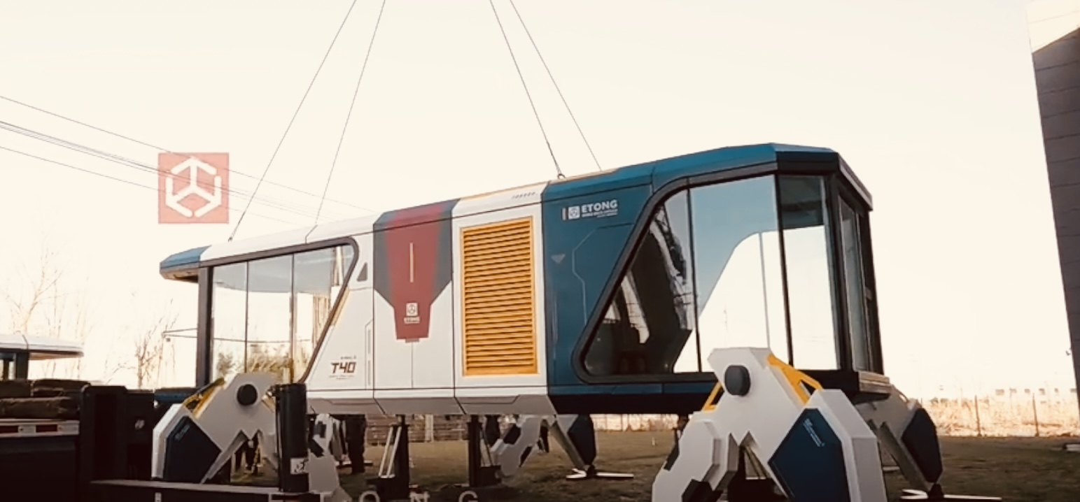
Rapid Manufacturing and Installation
30-day production cycle
Factory one-time molding
2-hour quick installation

Slide 11
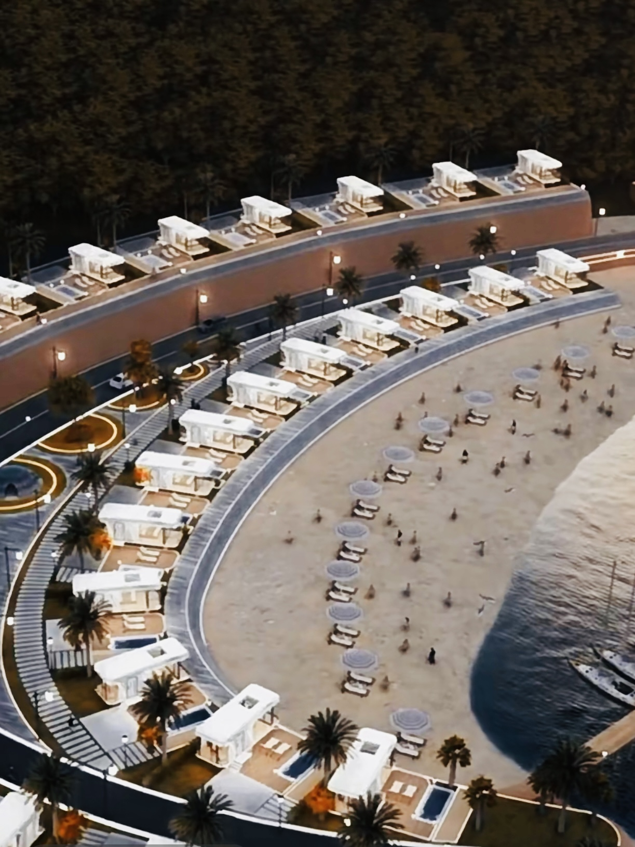
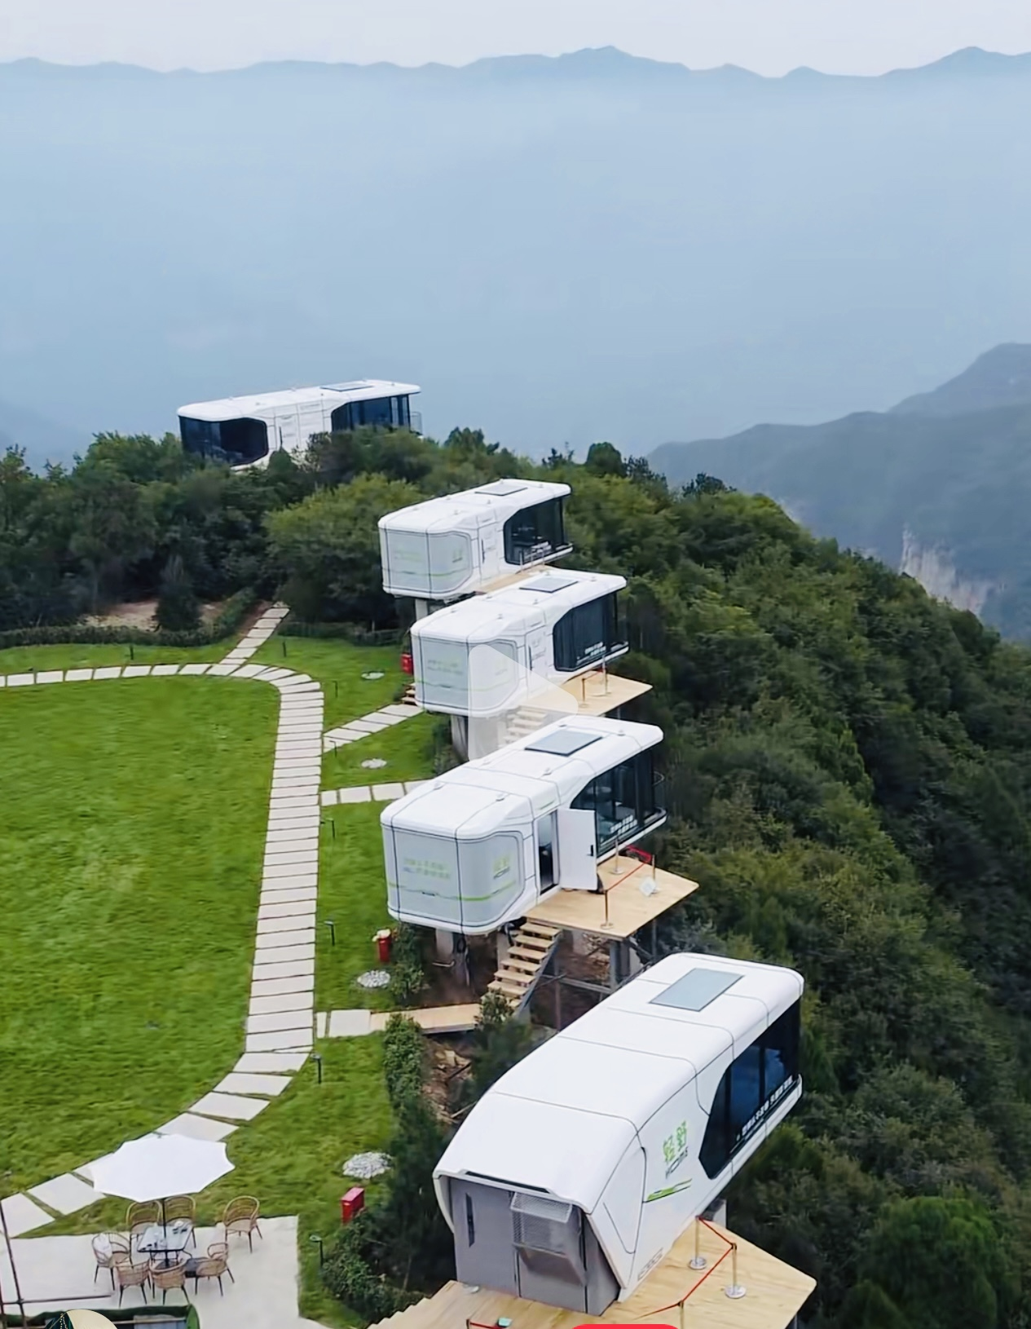
Versatile Applications
Ideal residential home
Vacation home
Cottage
Motel
Rental property

Slide 12
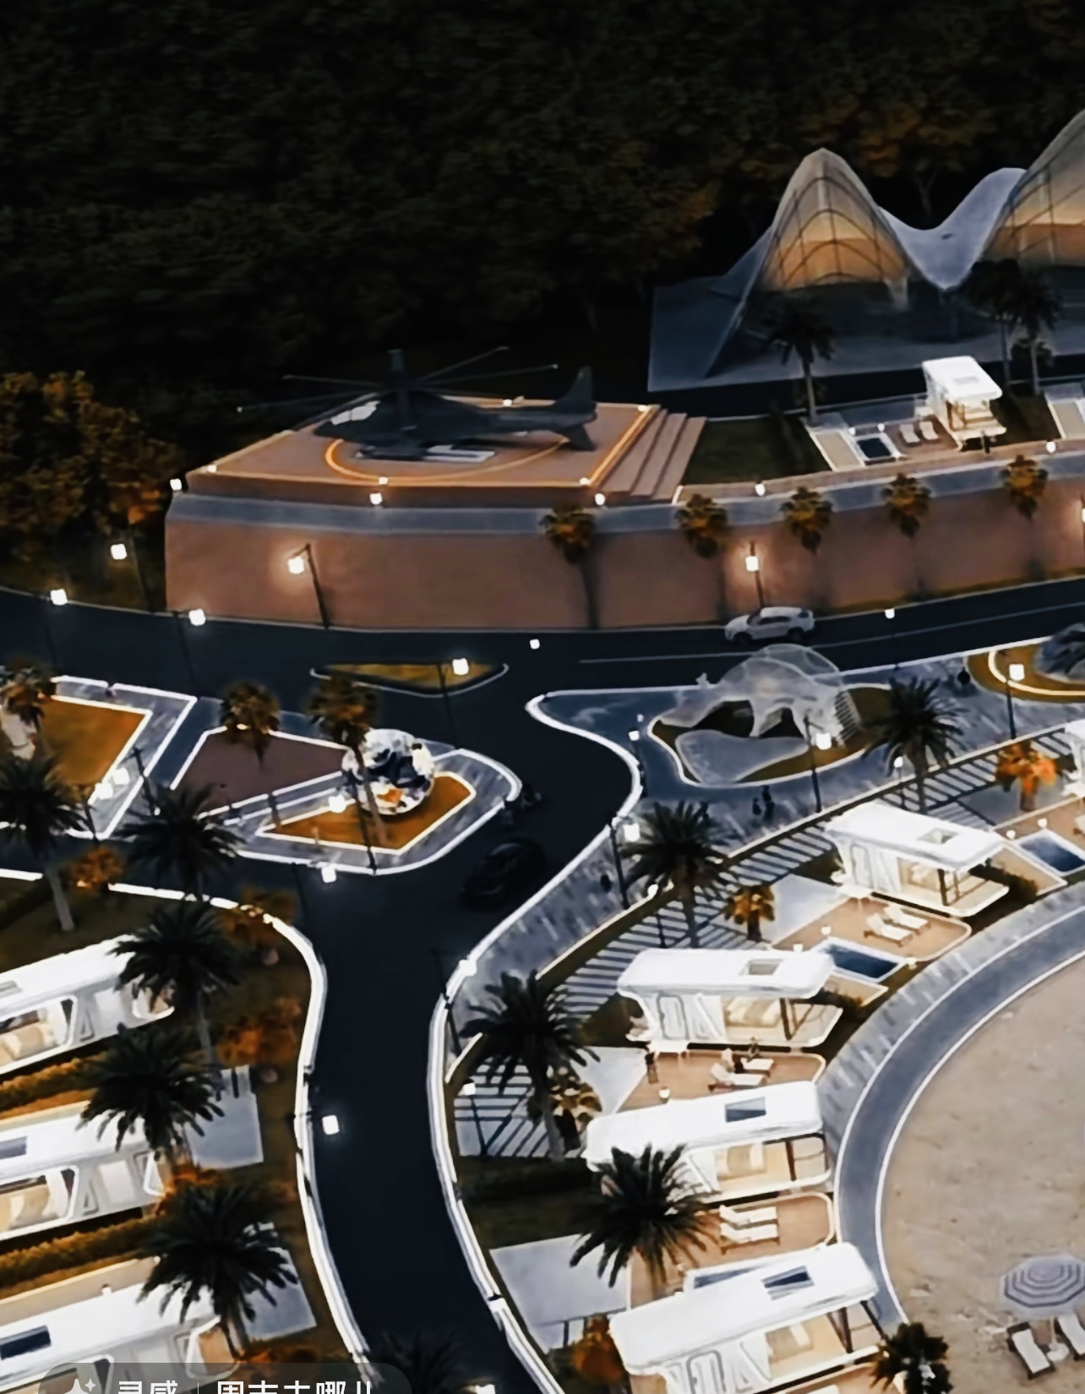
Space Capsule Smart Mobile Home Embark on a New Era of Smart Living
Contact us
902 330 6611
www.flourishdevelopmentgroup.com

Slide 13
Thank you !

